Slide 1
Logic Design
Synchronous Sequential Logic

Slide 2
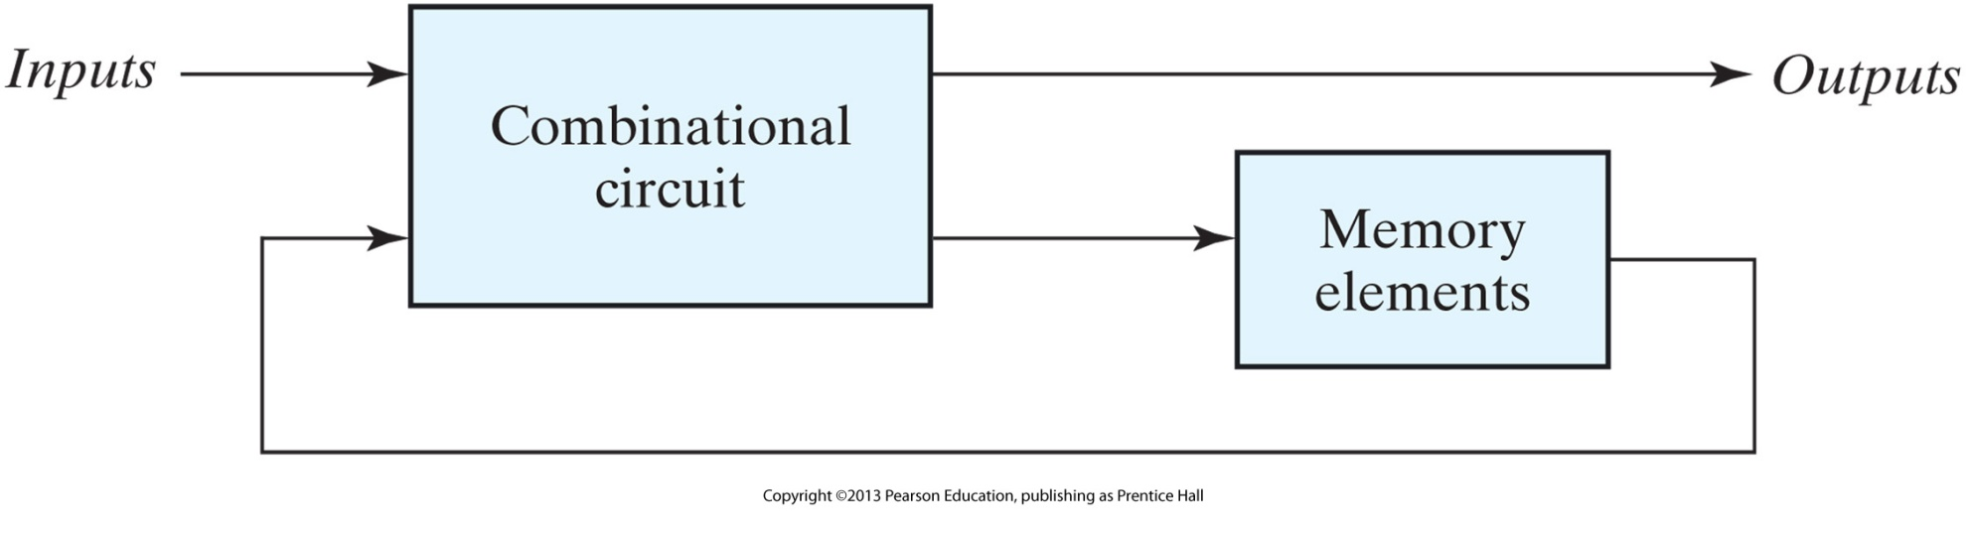
Sequential Logic
Any system that includes memory elements is described in terms of sequential logic.
A sequential circuit generally consists of a combinational circuit to which memory elements are connected to form a feedback path.
The external outputs in a sequential circuit are a function not only of external inputs but also of the present state of of the memory elements
The next state of the memory elements is also a function of external inputs and the present state.

Slide 3
Sequential Logic
Two types of sequential circuits:
  Asynchronous（异步的）: behaviour depends on the order in which its input signals change and can be affected at any instant of time.
  Synchronous（同步的）: behaviour defined from knowledge of its signals at discrete instants of time - signals affect the memory elements at discrete instants of time.
  In synchronous sequential circuits, synchronization is achieved by a timing device, the master clock generator which generates a train of clock pulses (crystal oscillator)

Slide 4
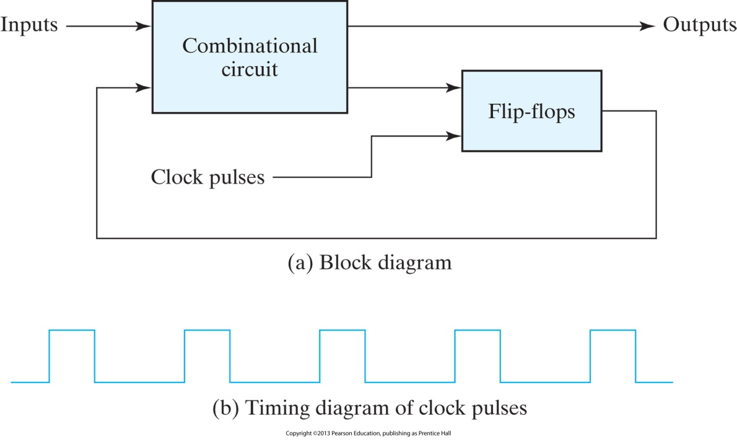
Clocks and Timing
The clock pulses are distributed throughout the system and are ADD-ed with the input signals
Clock cycle time: the time interval between the corresponding edges of 2 consecutive pulses
Clock frequency: number of pulses per sec (Hz): 1-500 MHz ⇔ 1000-2 nsec

Slide 5
Memory: flip-flops & latches
To create a 1-bit memory, we need a circuit that somehow remembers previous input values
A flip-flop circuit can maintain a binary state indefinitely until directed by an input signal to switch states
Flip-flops(触发器)
  edge triggered(边缘触发): state transition occurs during clock transition
  appropriate for synchronous sequential logic
Latches(插销)
  level triggered(水平触发): state transition occurs during pulse
  appropriate for Asynchronous sequential logic
  The period of the clock is decided by the slowest circuits and the farest distance

Slide 6
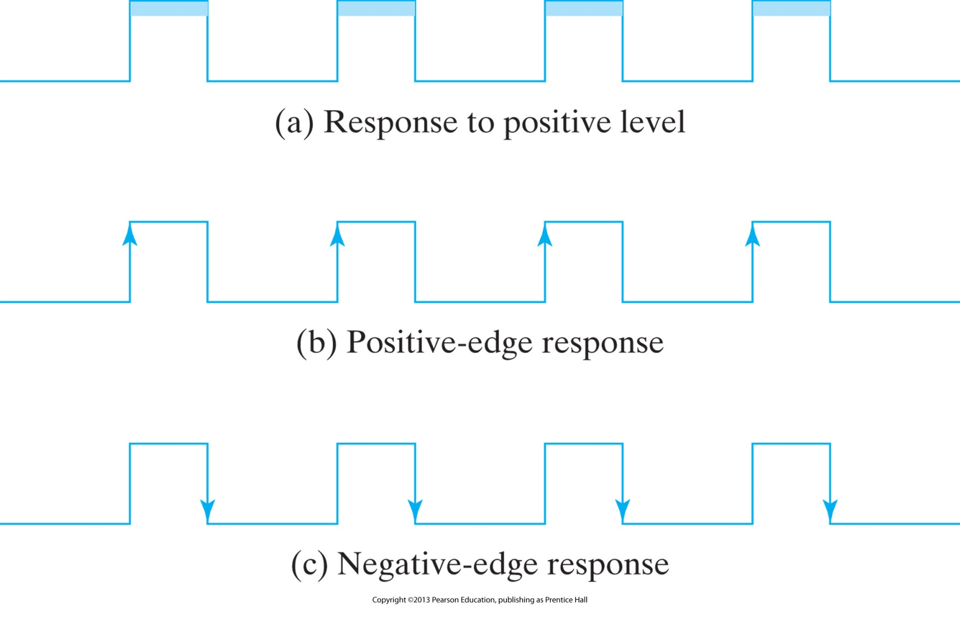
Clock Signalling

Slide 7
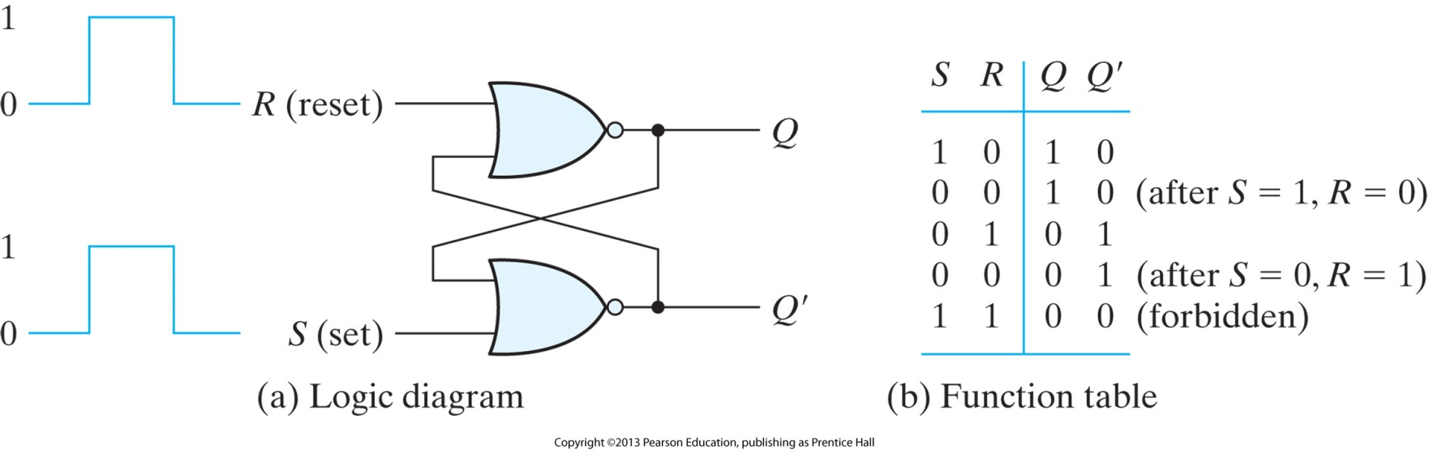
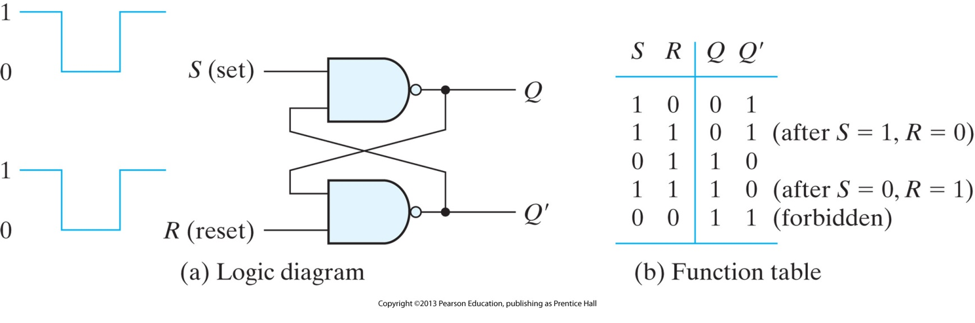
SR Latch

Slide 8
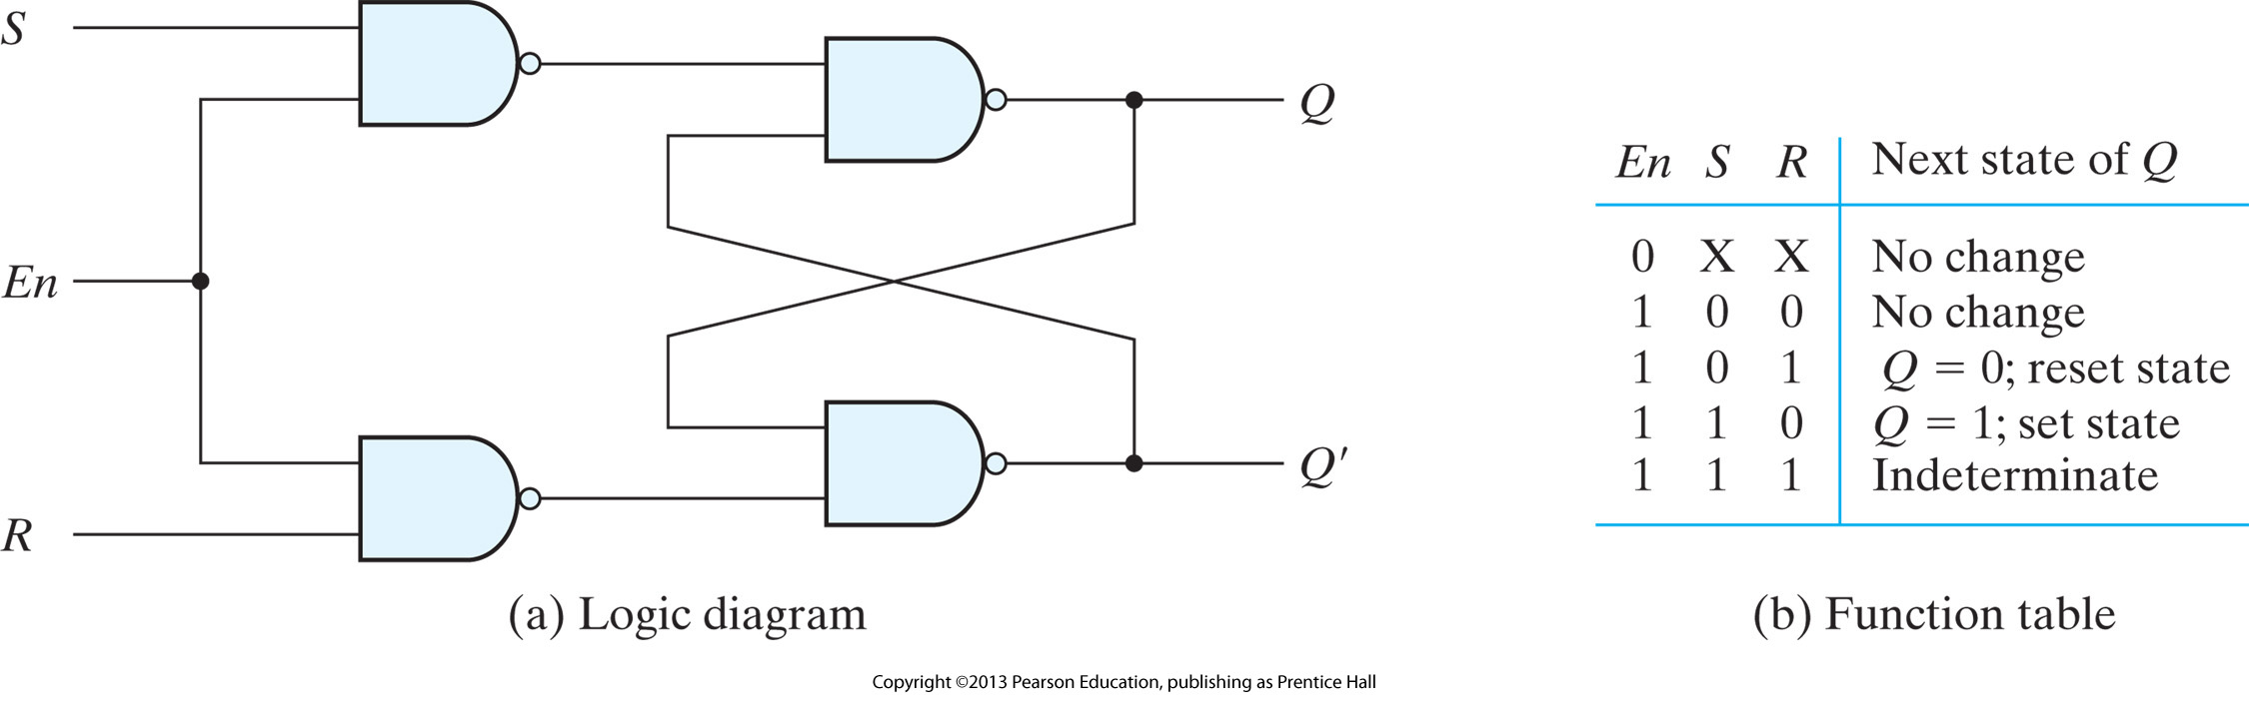
SR Latch with control

Slide 9
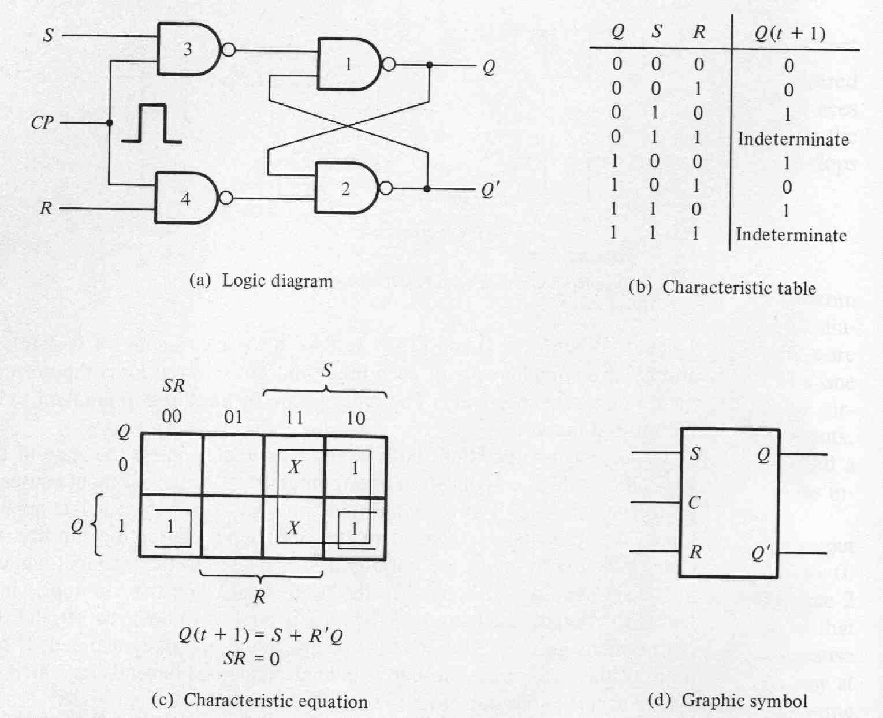

Clocked SR
RS f: problem with indeterminate states

Slide 10
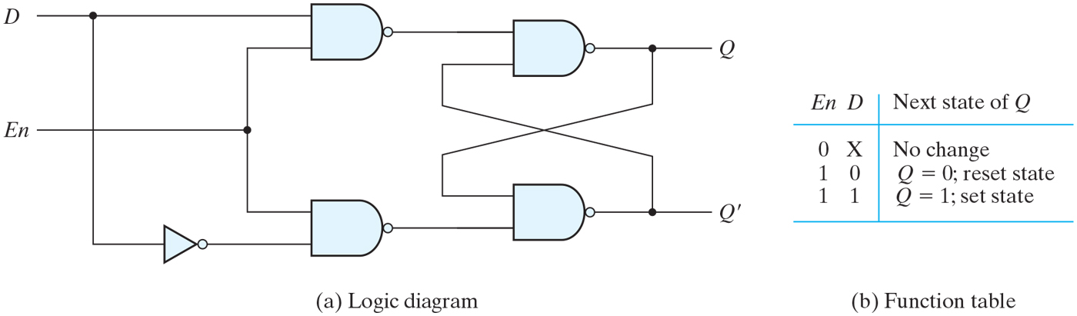
D Latch
One way to eliminate the undesirable condition of the indeterminate state in the SR latch is to ensure that inputs S and R are never equal to 1 at the same time.

Slide 11
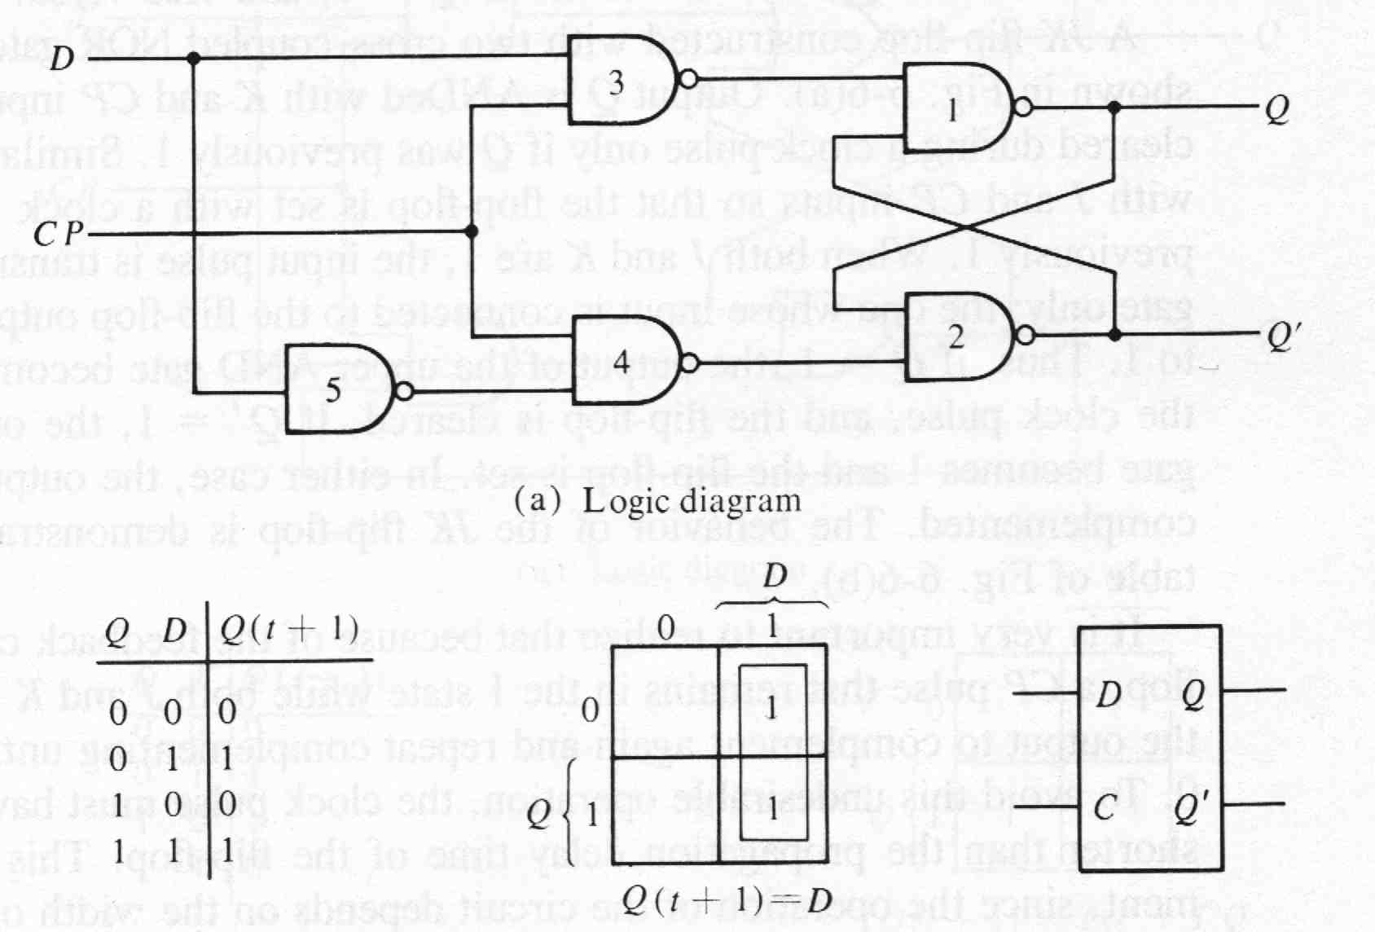
Clocked D Latch
D flip-flop: makes sure that R and S have complementary values

Slide 12
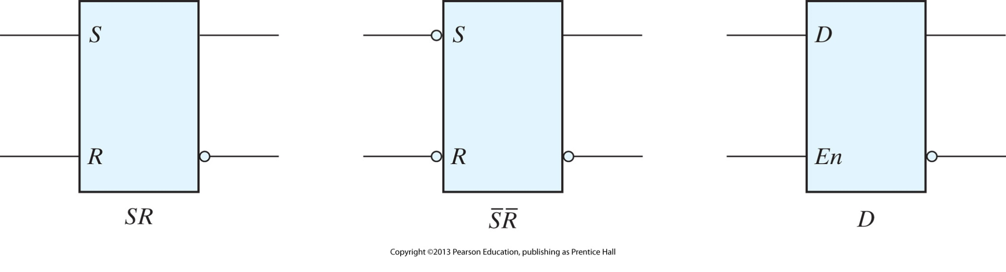
Graphic symbols for latches

Slide 13
Triggering of Flip Flops
The state of the flip flop is changed by a momentary change in the input signal: a trigger
The feedback path can produce instability if the outputs of the flip flops are changing while the outputs of the combinational circuit (flip flop inputs) are being sampled by the clock pulse.
Solutions:
  The outputs of the flip flops should not start changing until the clock pulse has returned to 0: The flip flop propagation delay > clock pulse duration.
  Make flip flop sensitive to transitions rather than pulses
    Edge Triggering: RC circuit in the clock input of the flip flop to cause a “spike”
    Master Slave

Slide 14
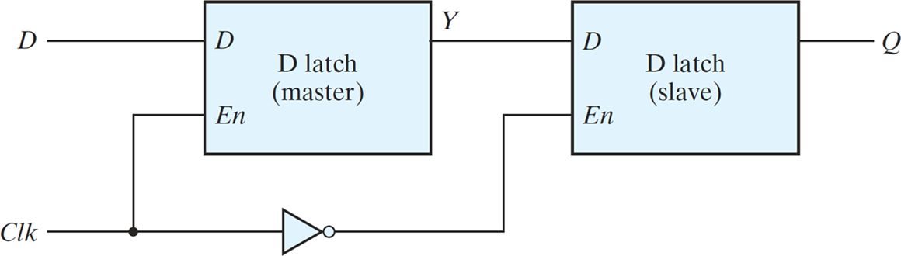
Latch to Flip-Flop
Employ two latches in a special configuration that isolates the output of the flip-flop and prevents it from being affected while the input to the flip-flop is changing.
The circuit samples the D input and changes its output Q only at the negative edge of the synchronizing or controlling clock (designated as Clk ).
The value that is produced at the output of the flip-flop is the value that was stored in the master stage immediately before the negative edge occurred .

Slide 15
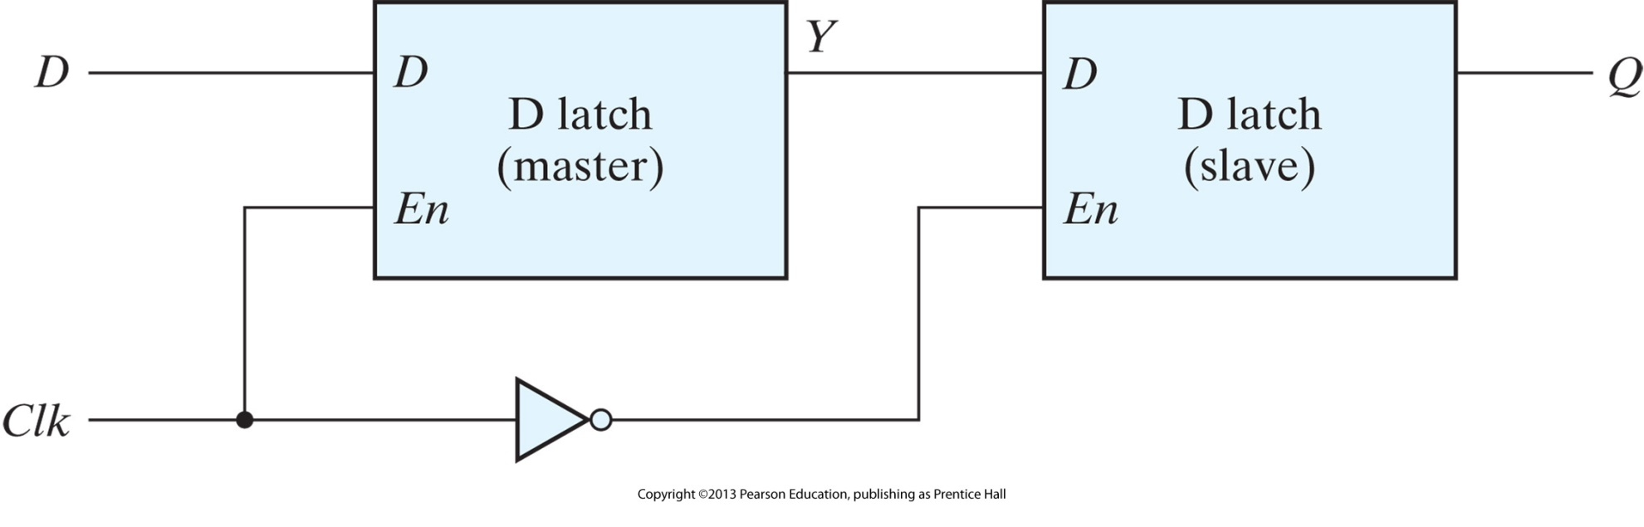
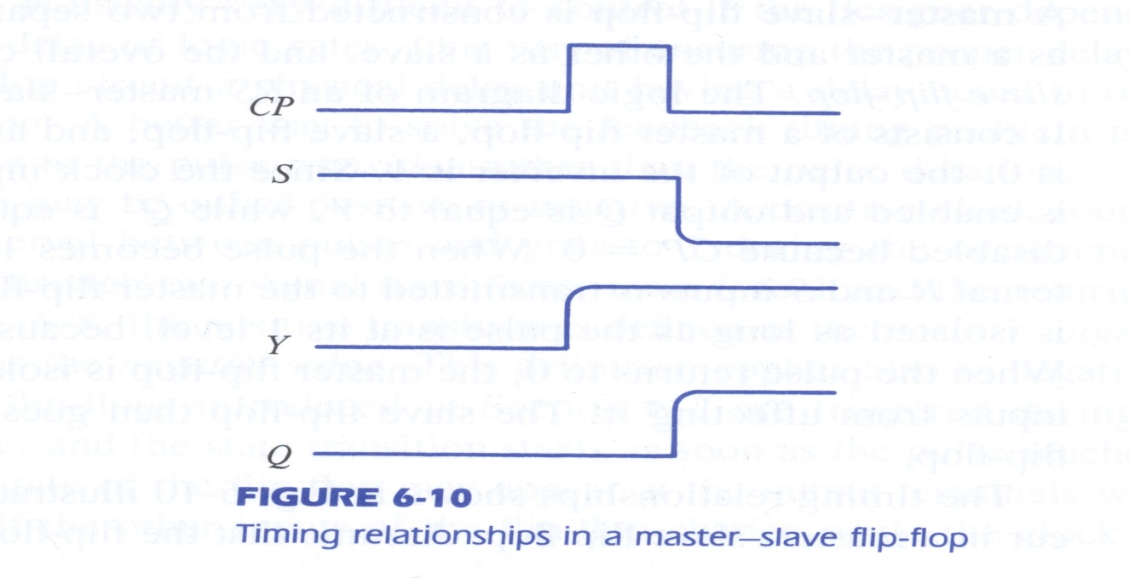
Master Slave

Slide 16
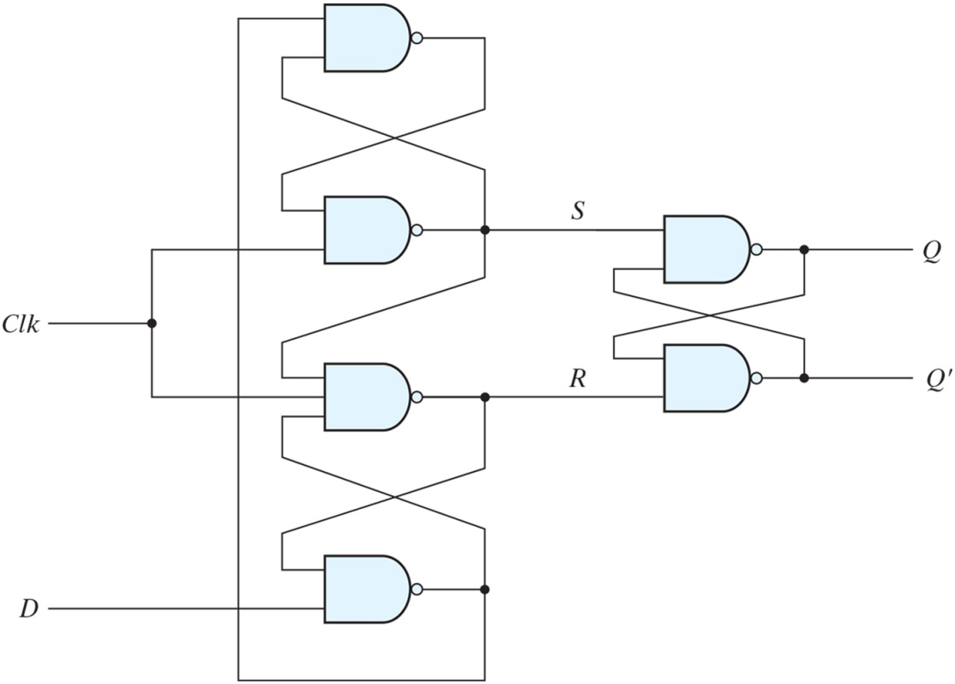
D-type positive-edge-triggered flip-flop
Another construction of an edge-triggered D flip-flop uses three SR latches
Two latches respond to the external D (data) and Clk (clock) inputs. The third latch provides the outputs for the flip-flop.
The S and R inputs of the output latch are maintained at the logic-1 level when Clk = 0. This causes the output to remain in its present state. Input D may be equal to 0 or 1. If D = 0 when Clk becomes 1, R changes to 0. This causes the flip-flop to go to the reset state, making Q = 0. If there is a change in the D input while Clk = 1, terminal R remains at 0 because Q is 0. Thus, the flip-flop is locked out and is unresponsive to further changes in the input. When the clock returns to 0, R goes to 1, placing the output latch in the quiescent condition without changing the output. Similarly, if D = 1 when Clk goes from 0 to 1, S changes to 0. This causes the circuit to go to the set state, making Q = 1. Any change in D while Clk = 1 does not affect the output.

Slide 17
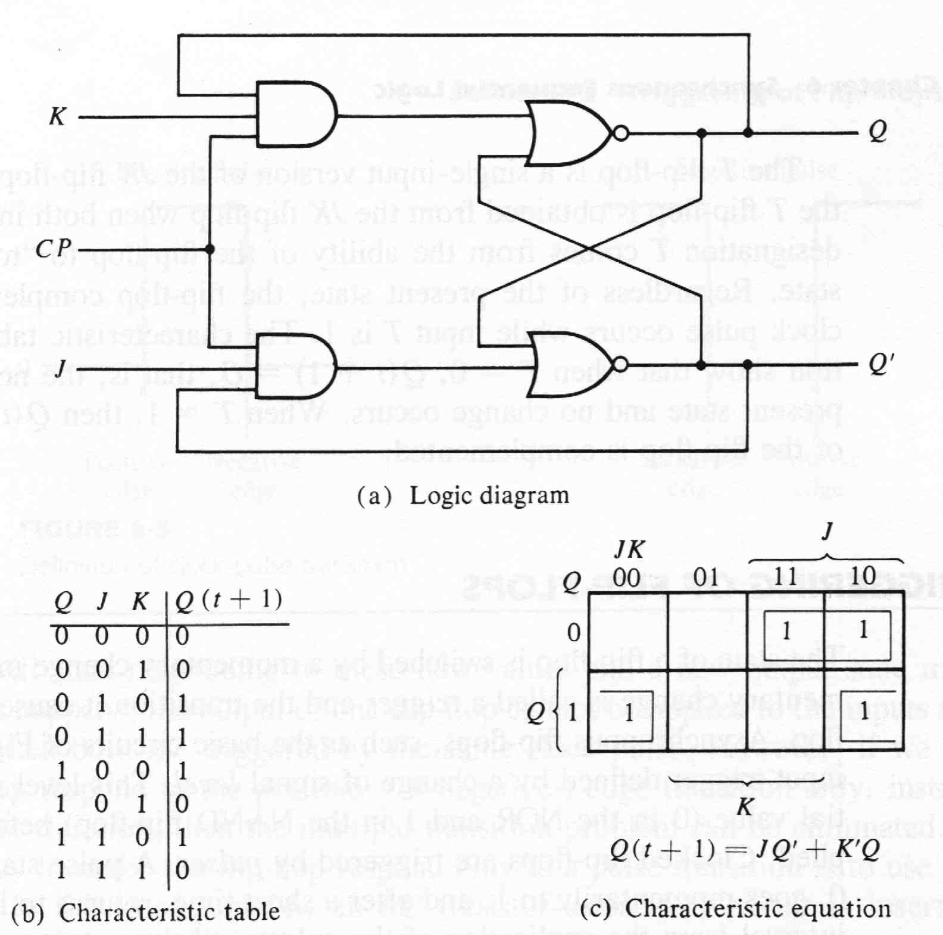
JK Flip flop
SR indeterminate state is defined in JK

Slide 18
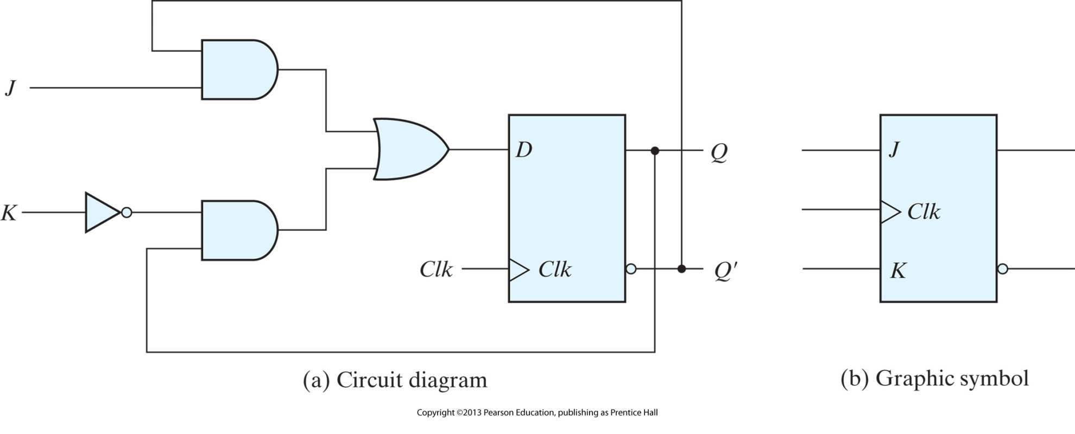
JK Flip flop

Slide 19
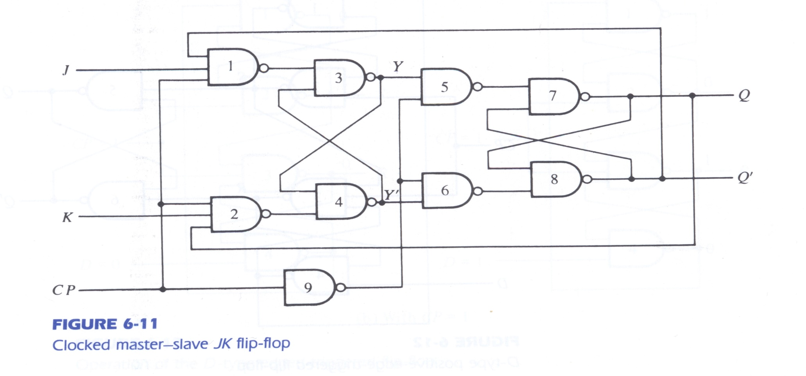
JK Master Slave

Slide 20
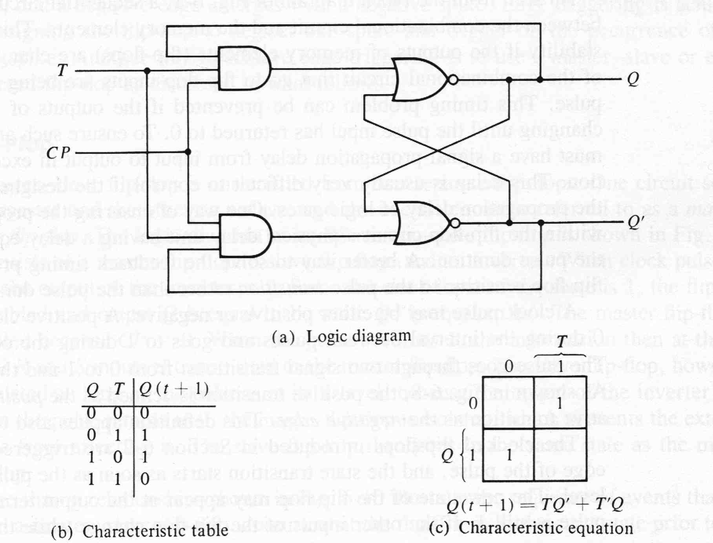
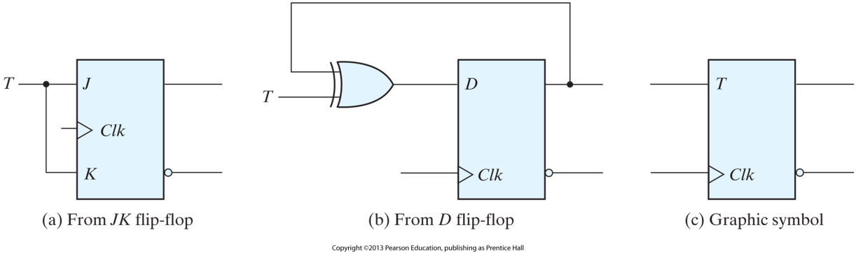
T Flip flop

Slide 21
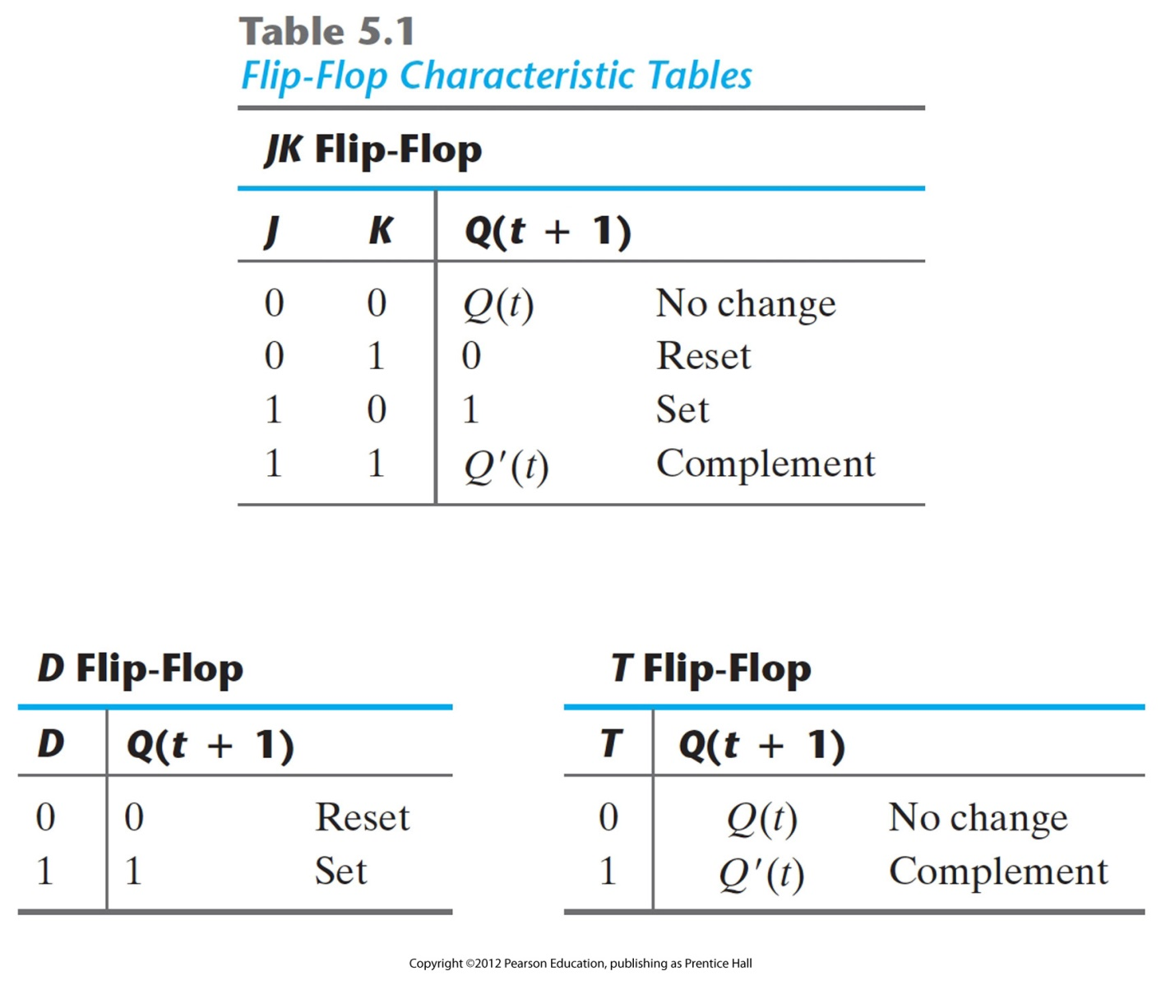
Characteristic Tables

Slide 22
Analysis of Clocked Sequential Circuits
The behaviour of a sequential circuit is defined by its inputs, its outputs and the current state of the flip-flops.
The analysis consists of obtaining a table or a diagram for the time sequence of inputs, outputs and internal states.
  State Equations: An algebraic expression that specifies the condition for a flip flop state transition
  State Table: enumerates the time sequence of inputs, outputs and flip flop states
  State Diagram: graphical representation
  Flip flop input functions: boolean functions that describe the part of the circuit that generates the inputs to flip flops
  Characteristic Tables: describe the relationship between the inputs of the flip flops and the next state

Slide 23
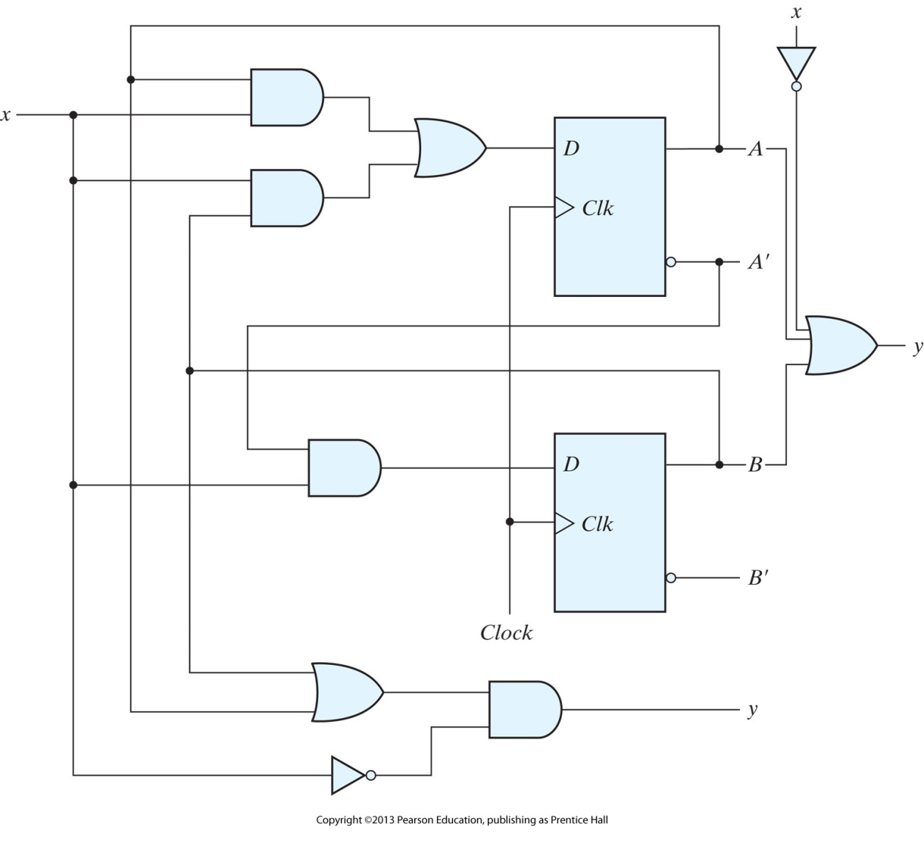
Sequential Circuit Example
A 0-detector: asserting its output when 0 is detected in a stream of 1s.
State Equations
    A(t+1)=A(t) x(t) + B(t) x(t)
    B(t+1) = A’(t) x(t)
    A(t+1) = Ax +Bx
    B(t+1) = A’x
    y(t)= [A(t)+B(t)] x’(t)
D_{A}=Ax+Bx
D_{B}=A’x
Y = (A+B)x’

Slide 24
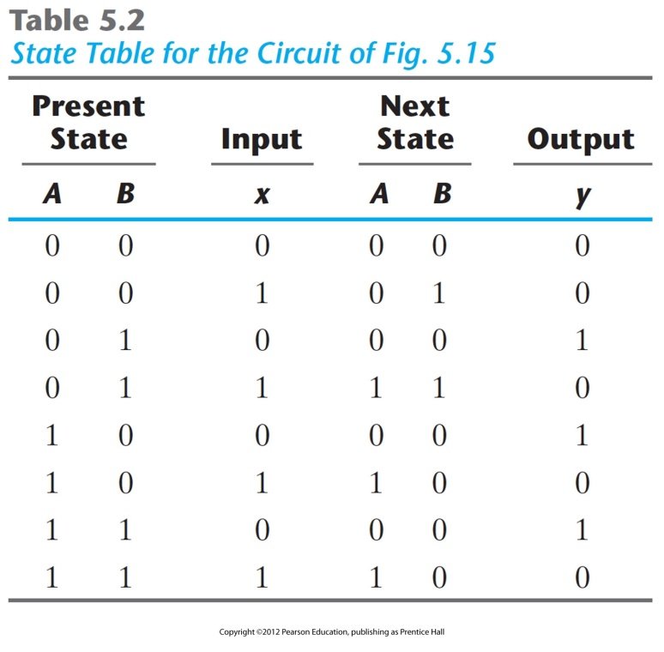
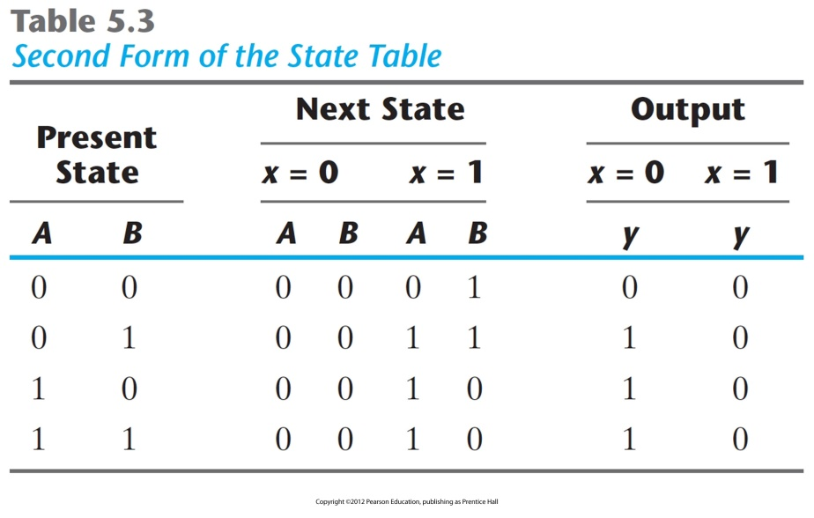
State Tables

Slide 25
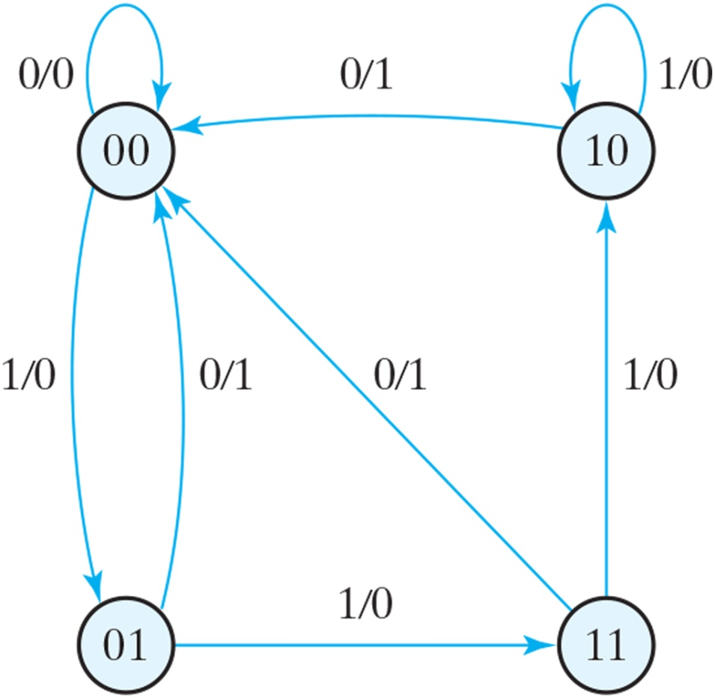
State Diagram
Each circle represent s a state of the flip flops
Directed lines: input value of the circuit / output during the present state

Slide 26
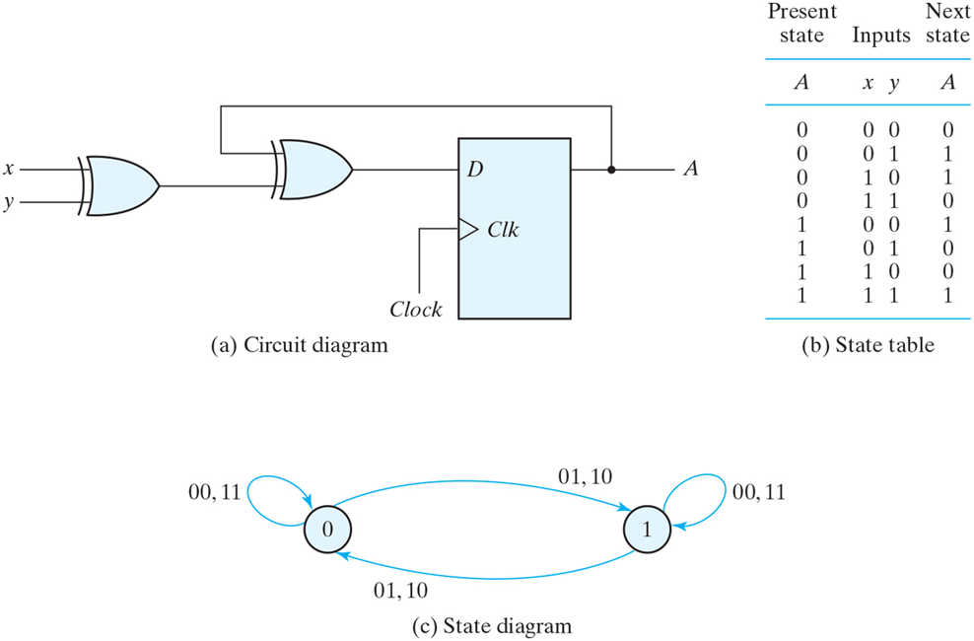
Analysis with D Flip-flops
D_{A} = A XOR x XOR y
A(t+1)=A XOR x XOR y

Slide 27
Analysis with JK Flip Flops
For sequential circuits with D flip flops, the next state values can be derived directly from the next-sate equations
With other types of flip flops, it is necessary to refer to the characteristic table.
The next state values of a sequential circuit that uses any other type of flip flop can be derived:
  Obtain the binary values of each flip-flip input function in terms of present state and input variables
  Substitute the input equations into the flip-flop characteristic equation to obtain the state equations.
  Use the corresponding flip-flop characteristic table to determine the next state.

Slide 28
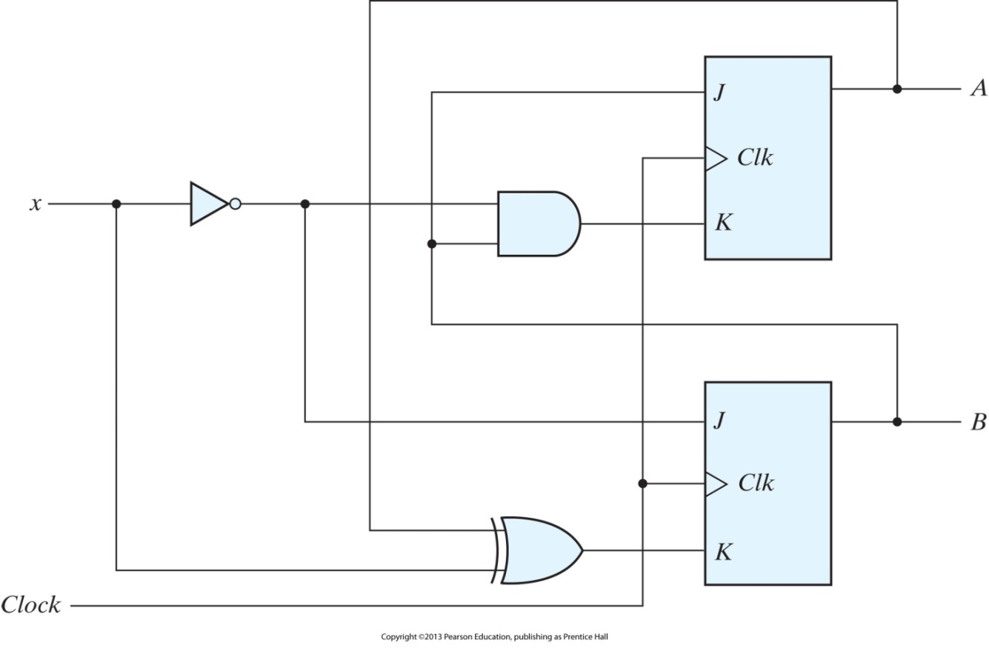
Analysis with JK Flip Flops
J_{A}=B
K_{A}=Bx’
J_{B}=x’
K_{B}=A’x + Ax’
A(t + 1) = JA’+ K’A
B(t + 1) = JB’+ K’B
A(t + 1) = BA’+ (Bx’)’ A = A’B + AB’+ Ax
B(t + 1) = x’B’+ (A XOR x)’ B = B’x’+ ABx + A’Bx’

Slide 29
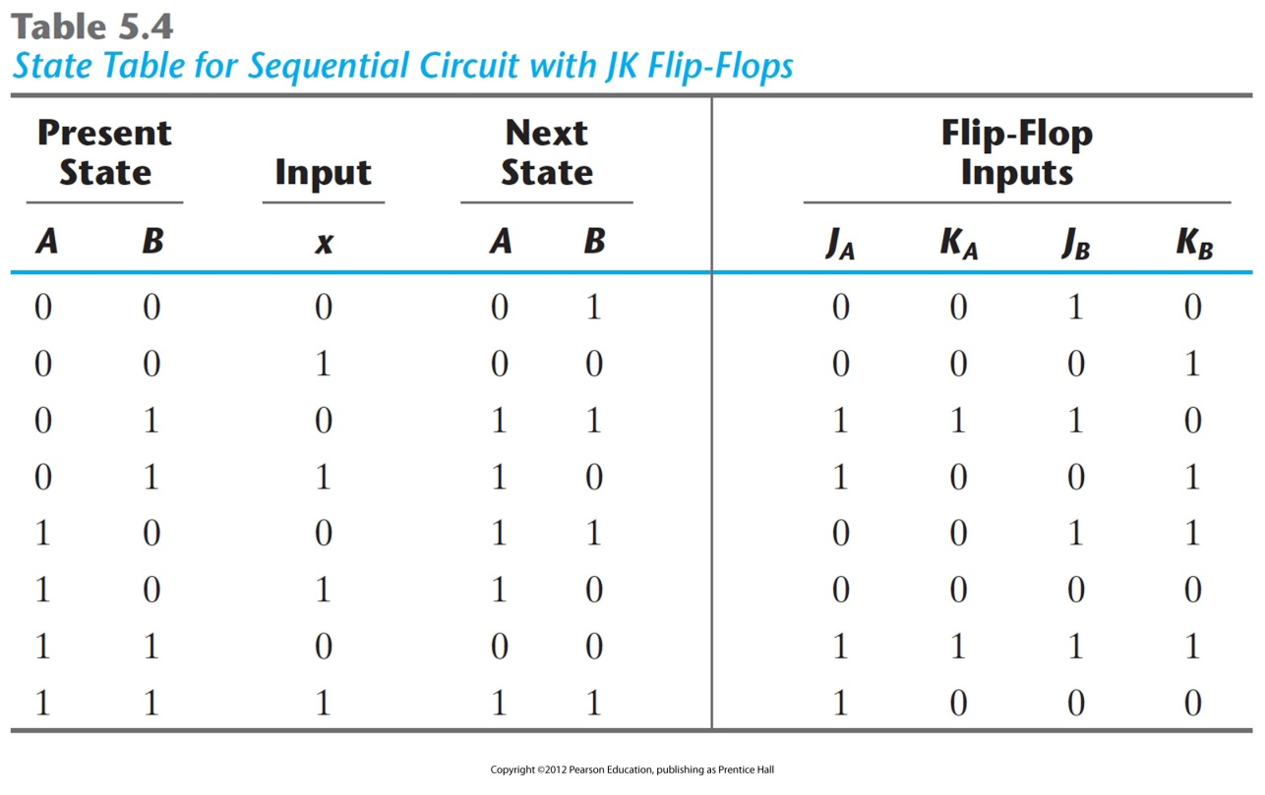
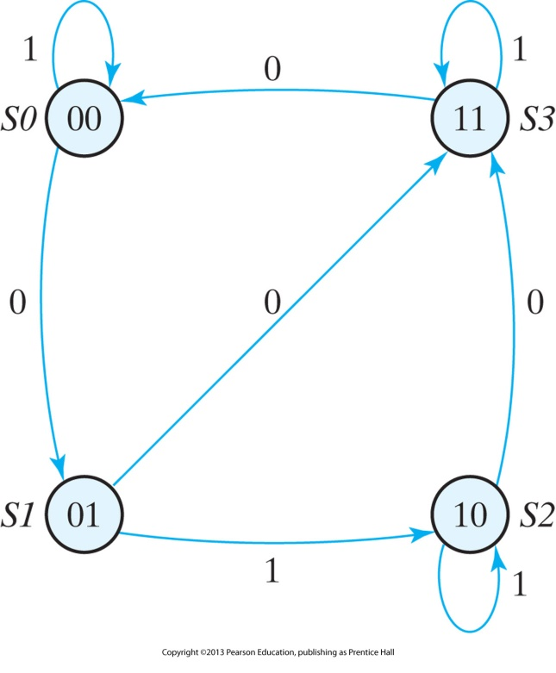
Analysis with JK Flip Flops

Slide 30
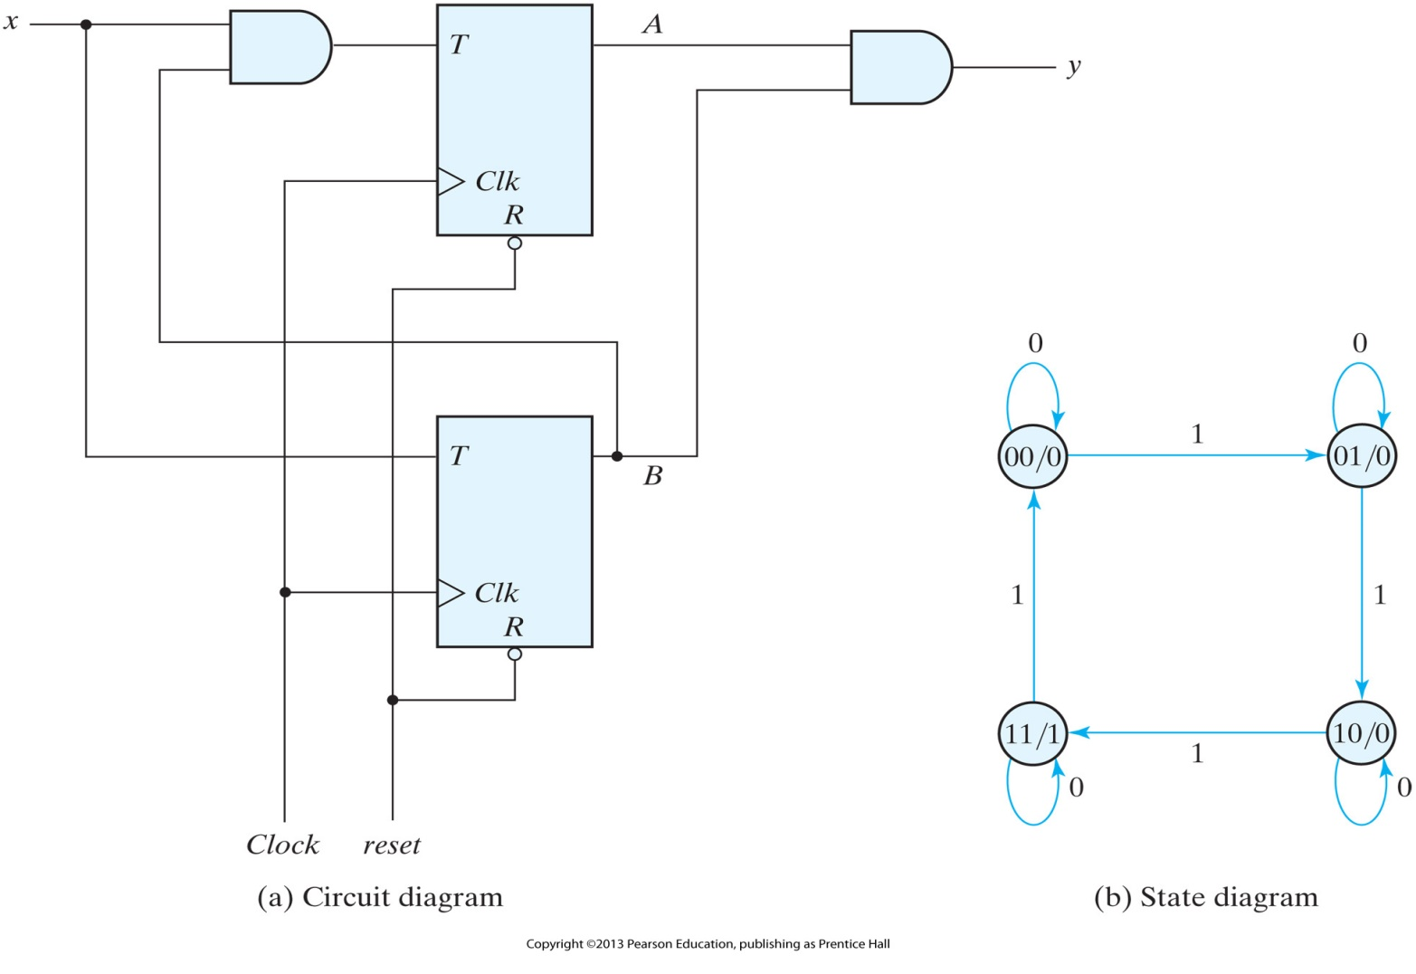
Sequential circuit with T flip-flops (Binary Counter)
Q(t + 1) = T XOR Q = T’Q + TQ’
T _{A} = Bx
T _{B} = x
y = AB

Slide 31
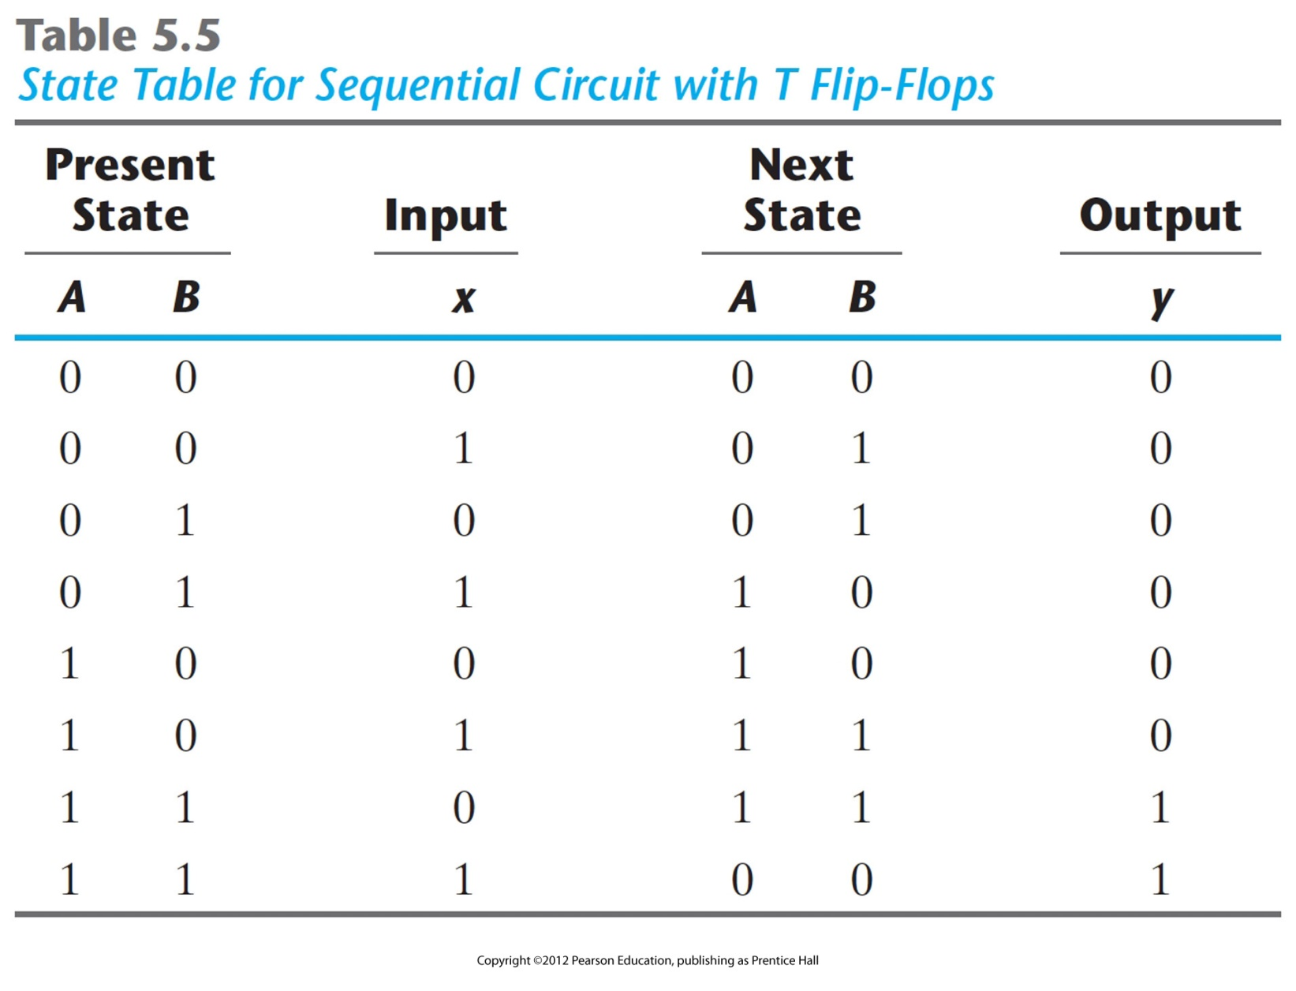

Slide 32
Mealy and Moore Models
Two types of Sequential Circuits:
  Mealy
    Outputs are functions of both present state and inputs
    Outputs may change if inputs change: inputs synchronised with clock
  Moore
    Outputs are functions of present state only
    Outputs are synchronised with clock

Slide 33
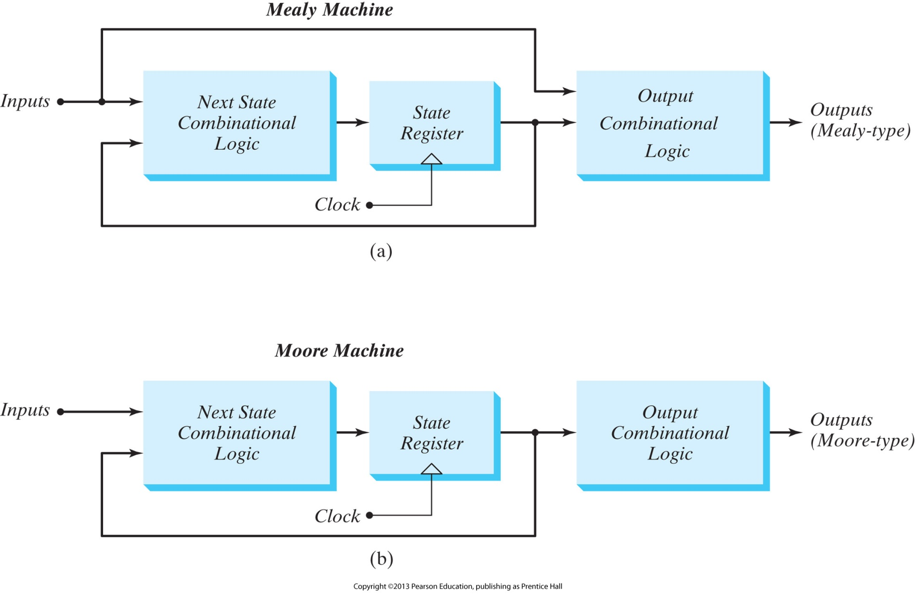
Mealy and Moore Models

